Slide 1

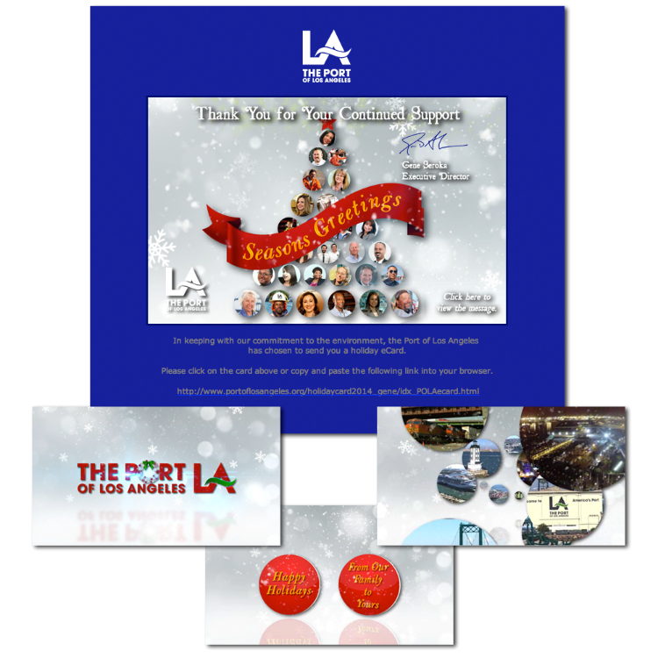
Port of
Los Angeles
Holiday Greeting 2014
Miscellaneous

